Slide 1
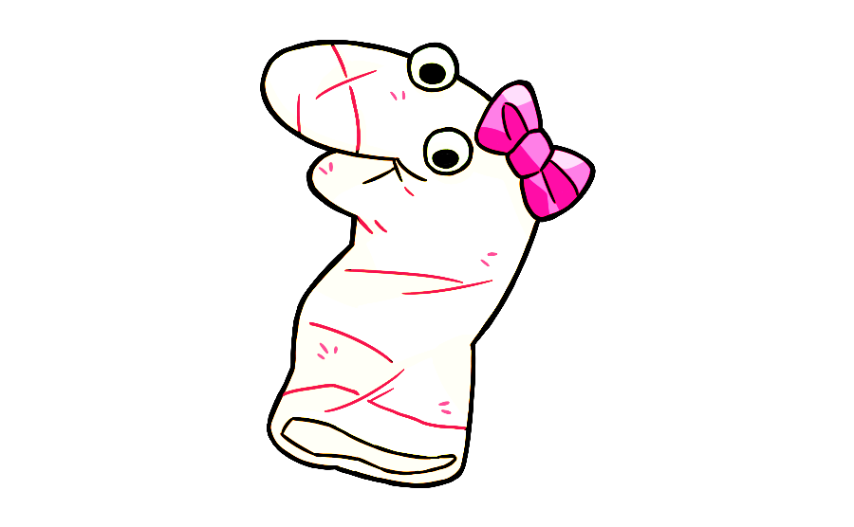
Notes:
This is Maggie! Say high to Maggie. Hi Maggie [wiggle]. Maggie wants to learn what things are for. And today you are going to teach Maggie what different things are for. Are you ready to help Maggie? OK, let’s help Maggie!

Slide 2
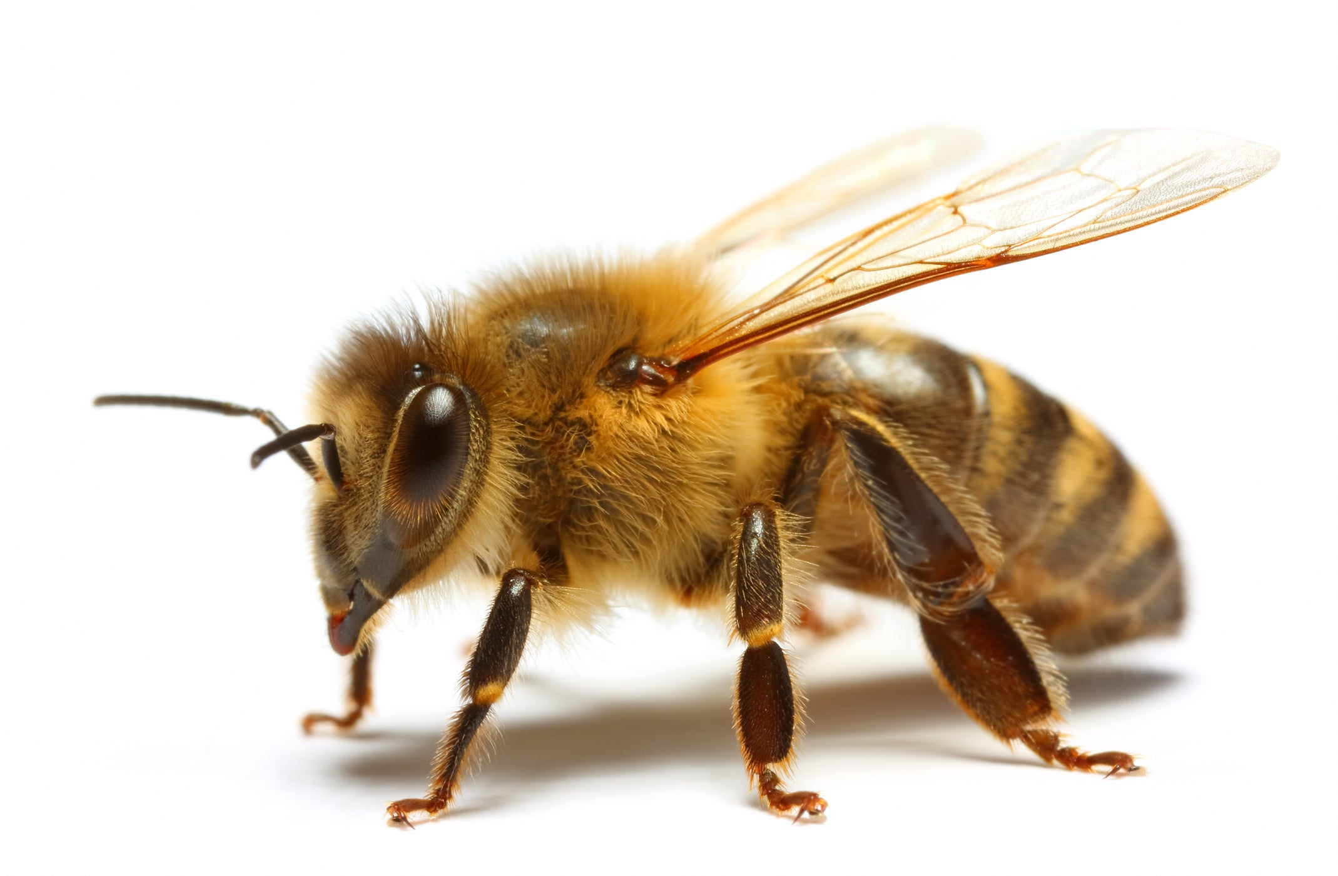
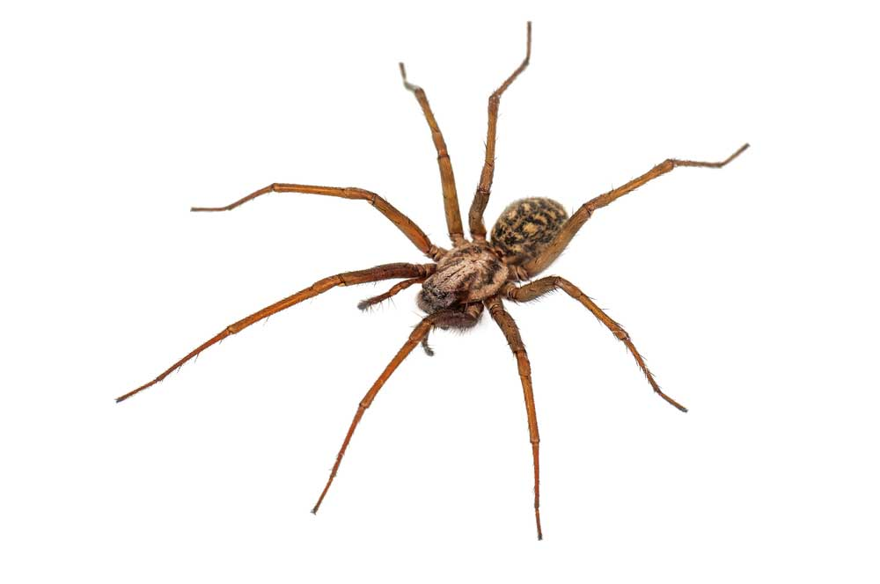
Notes:
See this [wiggle]? This is a bee! See this [wiggle]? This is a spider! Do you think bees or spiders are for making honey?

Slide 3
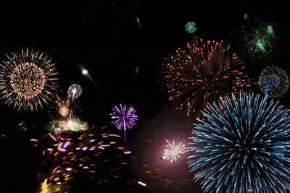

Notes:
Thanks so much for helping Maggie! Let’s see the next thing!

Slide 4
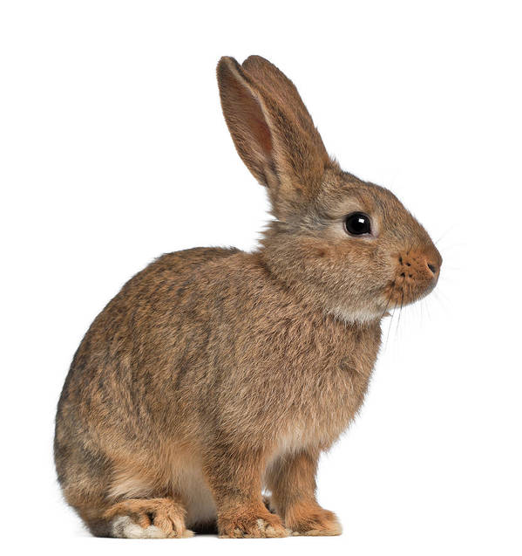
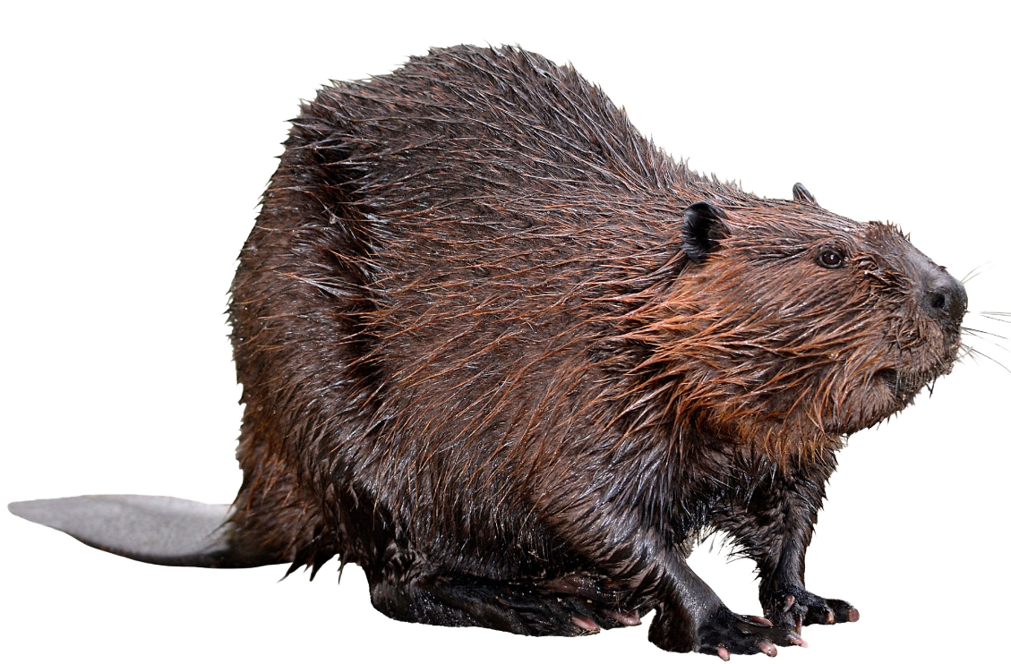
Notes:
See this [wiggle]? This is a bunny! See this [wiggle]? This is a beaver! Do you think bunnies or beavers are for building dams?

Slide 5
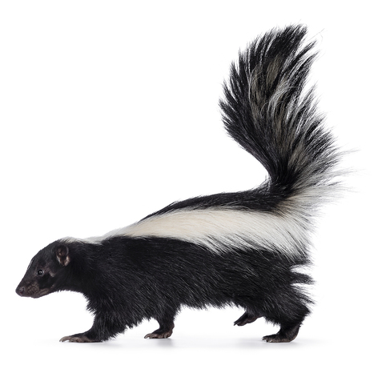
Notes:
See this [wiggle]? This is a skunk! See this [wiggle]? This is a bunny! Do you think skunks or bunnies are for hopping?

Slide 6
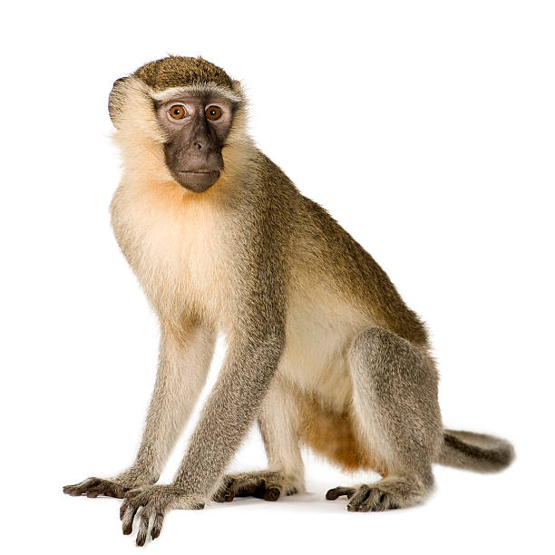
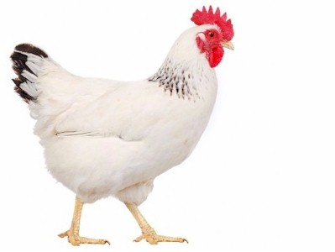
Notes:
See this [wiggle]? This is a chicken! See this [wiggle]? This is a monkey! Do you think chickens or monkeys are for laying eggs?

Slide 7
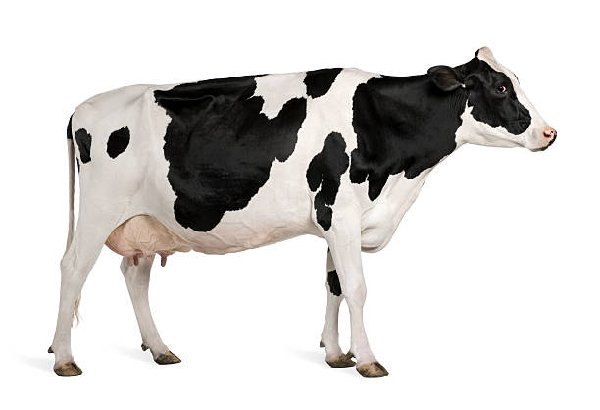
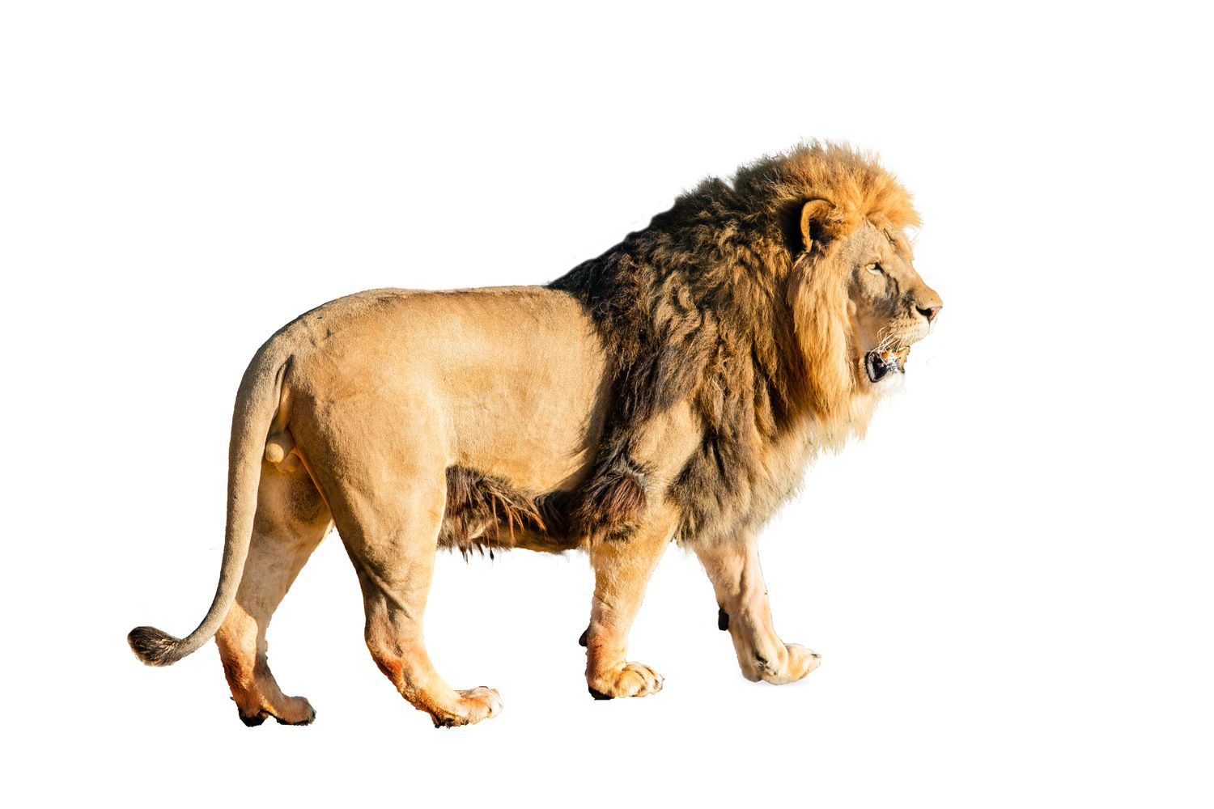
Notes:
See this [wiggle]? This is a cow! See this [wiggle]? This is a lion! Do you think cows or lions are for making milk?

Slide 8
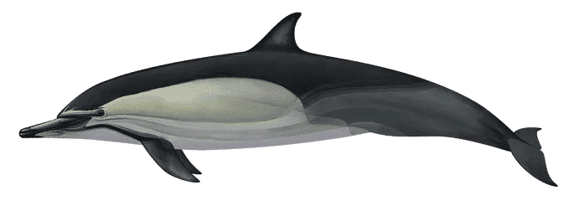
Notes:
See this [wiggle]? This is a dolphin! See this [wiggle]? This is a cow! Do you think dolphins or cows are for jumping in the water?

Slide 9
Notes:
See this [wiggle]? This is a lion! See this [wiggle]? This is a dolphin! Do you think lions or doolphins are for roaring?

Slide 10
Notes:
See this [wiggle]? This is a monkey! See this [wiggle]? This is a skunk! Do you think monkeys or skunk are for swinging from trees?

Slide 11
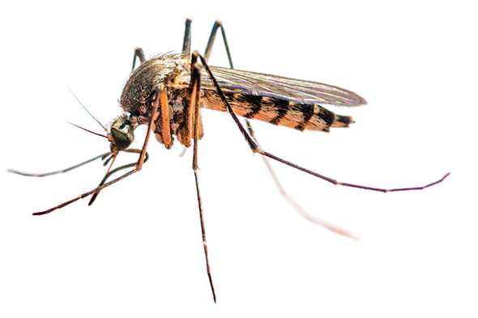
Notes:
See this [wiggle]? This is a bee! See this [wiggle]? This is a mosquito! Do you think bees or mosquitos are for biting people?

Slide 12
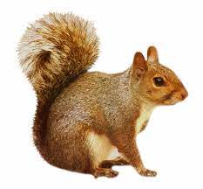
Notes:
See this [wiggle]? This is a skunk! See this [wiggle]? This is a squirrel! Do you think skunks or squirrels are for smelling stinky?

Slide 13
Notes:
See this [wiggle]? This is a mosquito! See this [wiggle]? This is a spider! Do you think mosquitos or spiders are for making webs?

Slide 14
Notes:
See this [wiggle]? This is a beaver! See this [wiggle]? This is a squirrel! Do you think beavers or squirrels are for eating nuts?

Slide 15
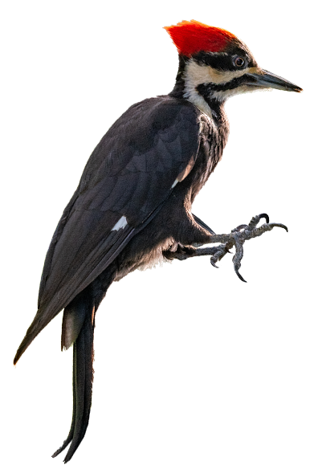
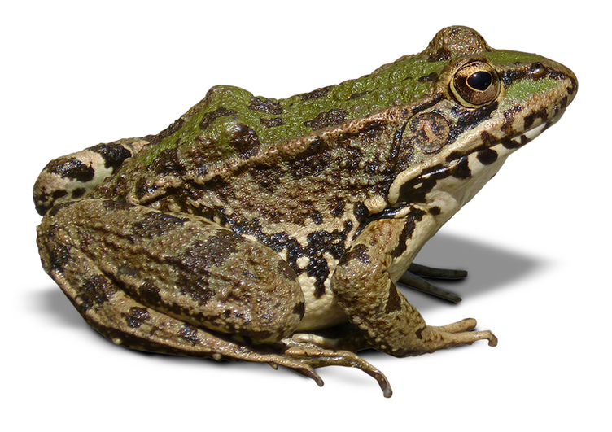
Notes:
See this [wiggle]? This is a woodpecker! See this [wiggle]? This is a frog! Do you think woodpeckers or frogs are for pecking wood?

Slide 16
Notes:
See this [wiggle]? This is a frog! See this [wiggle]? This is a chicken! Do you think frogs or chickens are for jumping?

Slide 17
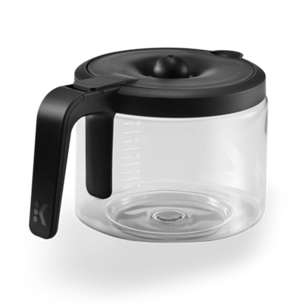
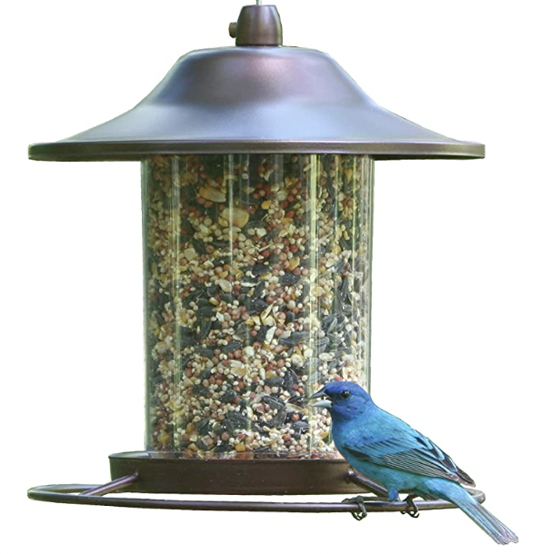
Notes:
See this [wiggle]? This is a bird feeder! See this [wiggle]? This is a coffeepot! Do you think birdfeeders or coffeepots are for feeding birds?

Slide 18
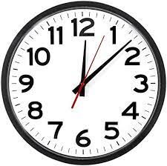
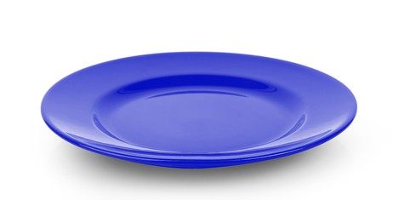
Notes:
See this [wiggle]? This is a clock! See this [wiggle]? This is a plate! Do you think clocks or plates are for telling time?

Slide 19
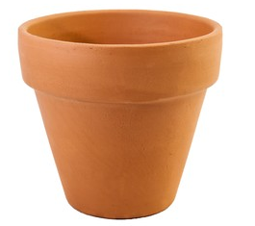
Notes:
See this [wiggle]? This is a coffeepot! See this [wiggle]? This is a flowerpot! Do you think coffeepots or flowerpots are for holding coffee?

Slide 20
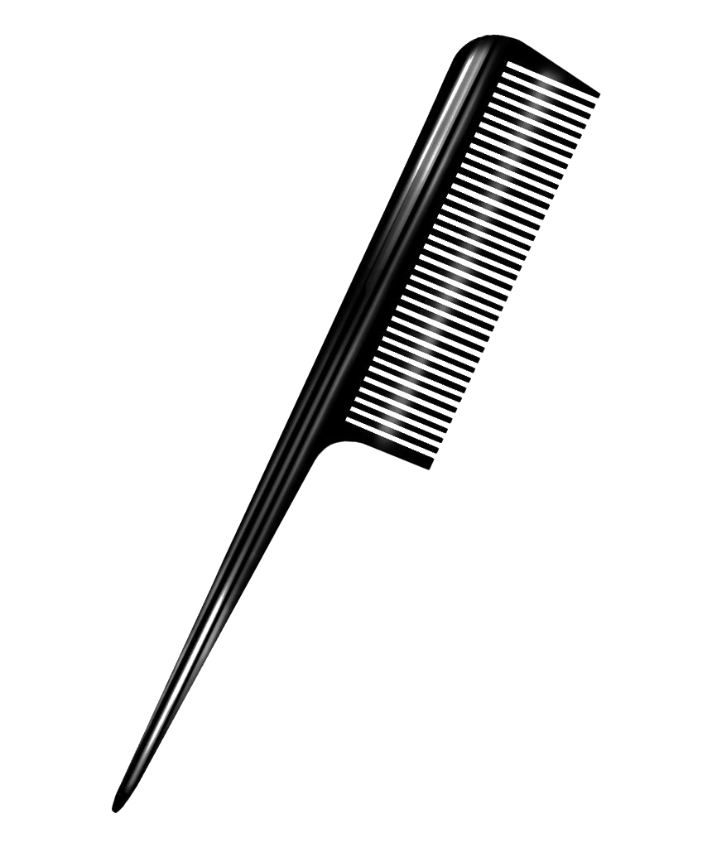
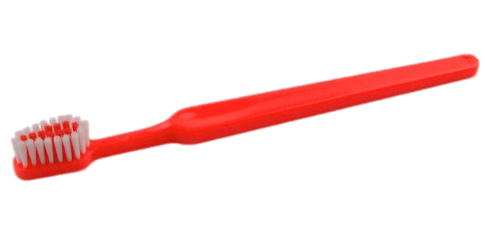
Notes:
See this [wiggle]? This is a comb! See this [wiggle]? This is a toothbrush! Do you think combs or toothbrushes are for brushing hair?

Slide 21
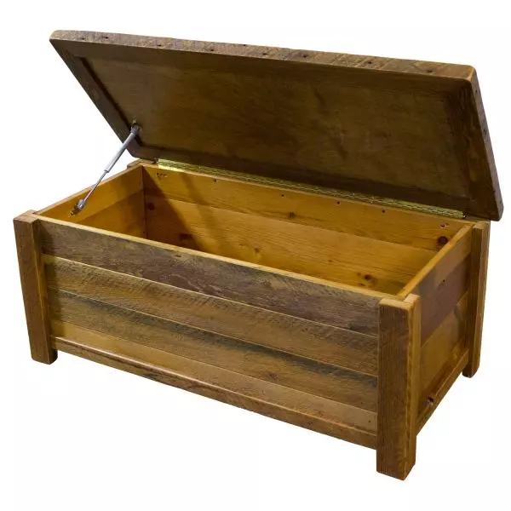
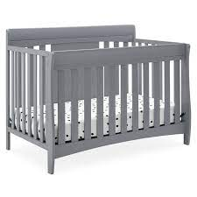
Notes:
See this [wiggle]? This is a crib! See this [wiggle]? This is a toybox! Do you think cribs or toyboxes are for babies to sleep in?

Slide 22
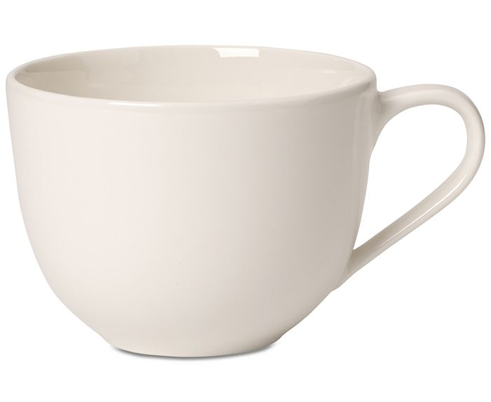
Notes:
See this [wiggle]? This is a cup! See this [wiggle]? This is a flowerpot! Do you think cups or flowerpots are for drinking?

Slide 23
Notes:
See this [wiggle]? This is a birdfeeder! See this [wiggle]? This is a flowerpot! Do you think birdfeeders or flowerpots are for growing flowers?

Slide 24
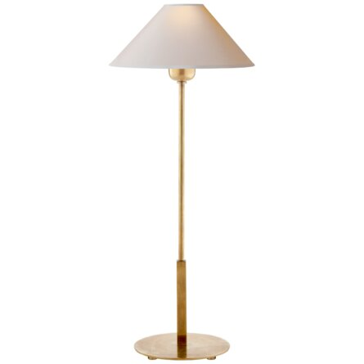
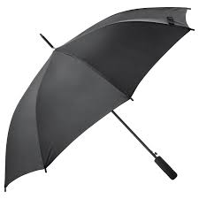
Notes:
See this [wiggle]? This is a lamp! See this [wiggle]? This is an umbrella! Do you think lamps or umbrellas are for providing light?

Slide 25
Notes:
See this [wiggle]? This is a plate! See this [wiggle]? This is a cup! Do you think plates or cups are for eating on?

Slide 26
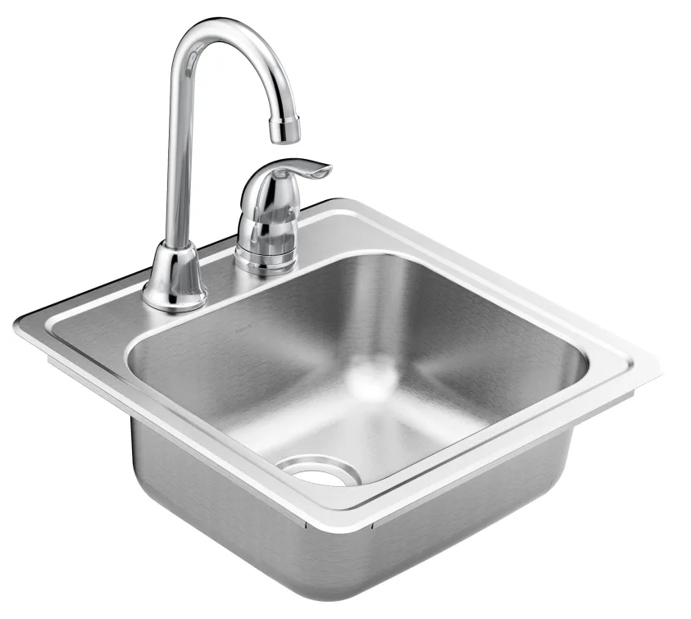
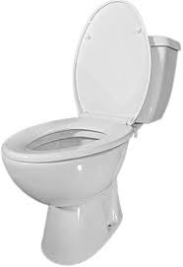
Notes:
See this [wiggle]? This is a sink! See this [wiggle]? This is a toilet! Do you think sinks or toilets are for washing your hands?

Slide 27
Notes:
See this [wiggle]? This is a toybox! See this [wiggle]? This is a toilet! Do you think toyboxes or toilets are for going to the bathroom?

Slide 28
Notes:
See this [wiggle]? This is a lamp! See this [wiggle]? This is a toothbrush! Do you think lamps or toothbrushes are for brushing teeth?

Slide 29
Notes:
See this [wiggle]? This is a toybox! See this [wiggle]? This is a sink! Do you think toyboxes or sinks are for putting toys in?

Slide 30
Notes:
See this [wiggle]? This is a comb! See this [wiggle]? This is an umbrella! Do you think combs or umbrellas are for protecting us from rain?

Slide 31
Notes:
Thanks so much for helping Maggie! We are about half way done. Do you want to keep helping Maggie? OK great let’s keep helping Maggie!

Slide 32
1. How was the video quality?
1
2
3
4
5
Very poor
Moderate
Very good
Notes:
can you tell me how the video quality was throughout the study, from 1 being the worst and 5 being the best?
Could you see me okay?

Slide 33
2. How was the sound quality?
1
2
3
4
5
Very poor
Moderate
Very good
Notes:
How about the sound quality? Could you hear me okay?

Slide 34
3. How fun was the activity?
1
2
3
4
5
Not very fun
Moderately fun
Very fun
Notes:
And how fun was the activity ?

Slide 35
Participant Recording Options
Please choose a level of consent option for your child’s video.
1. Research Only
Viewed only by our team.
2. Academic/Educational Use
May be presented as examples at conferences or classes.
3. Public
May be e.g. presented publicly online for public outreach & dissemination of findings.
Notes:
Lastly, how you would like us to use our recording of today’s session? The baseline level of privacy is level 1, research only, which means only the experimenters in our lab will have access to the videos.
I’d be happy to describe the 2 additional levels of privacy if you’re interested - they’re really helpful for us but totally optional. Level 2 allows us to use your child’s video as an example at conferences or classes. Level 3 means your child’s video may be made public. Which level of consent would you be comfortable with?

Slide 36

Expect your child’s $5 gift card to arrive in 1 – 5 business days!
Notes:
That was our last question – thank you so much for taking the time to participate in our study today!

